Slide 1
Unit 8 Grade 5
Weather
الطقس
Jack and his sisters enjoy the four seasons
جاك واخواته يستمتعون بالأربع فصول

Slide 2
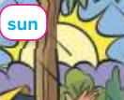
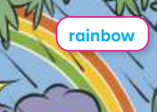
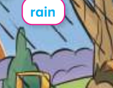
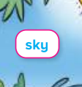
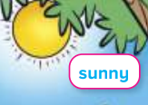
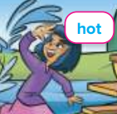
Sun الشمس
Rainbowقوس قزح
Rain مطر
Skyالسماء
Sunnyمشمس
Hot حار

Slide 3
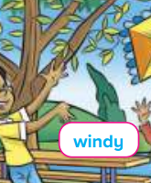
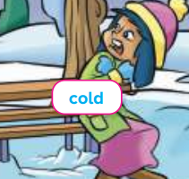
Windyعاصف
Cloud سحابة
Cloudyمغيم
Ice ثلج
Snowتمطر ثلج
Cold بارد

Slide 4
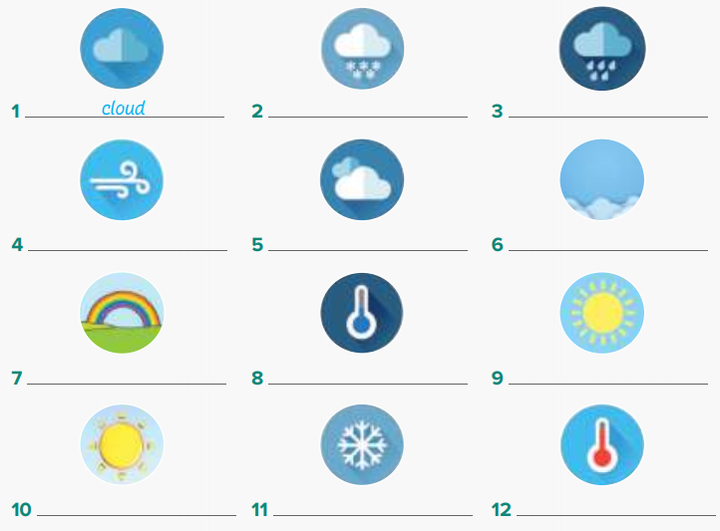
ما الطقس الذي تفضله؟
snow
rain
windy
cloudy
sky
rainbow
cold
sunny
sun
ice
hot

Slide 5
Read the following
Outside بالخارج
Highعالي
Lowمنخفض
Umbrellaشمسية
Grayرمادي
Walkيمشي

Slide 6
Let’s play a game

Slide 7
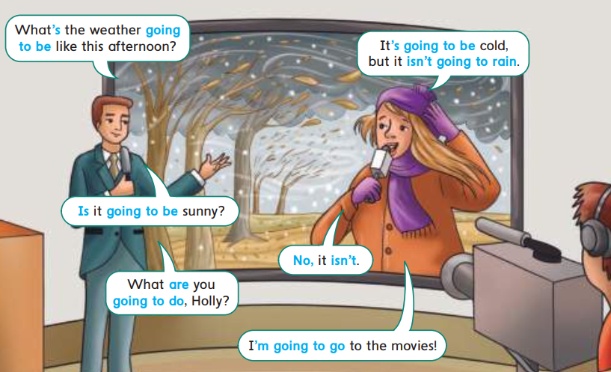
Read the following

Slide 8
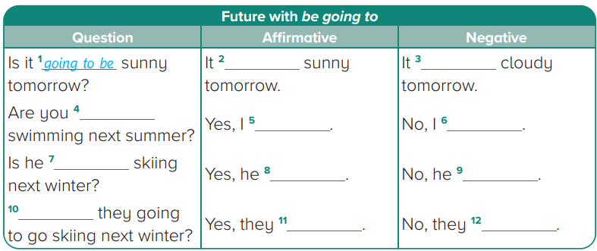
Grammar
is going to be
isn’t going to be
going to go
am not
am
going to go
is
isn’t
Are
are
aren’t

Slide 9
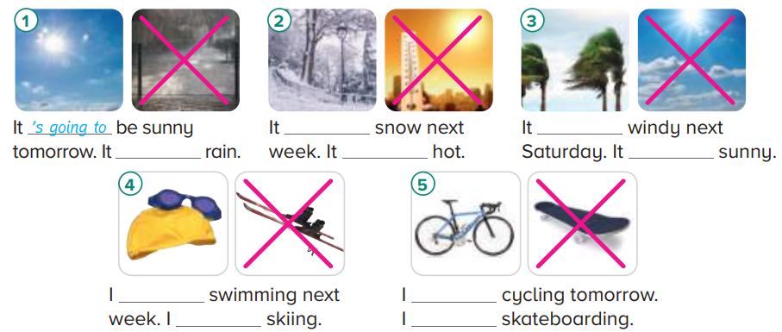
Complete the following sentences
is going to
is going to be
isn’t going to
isn’t going to be
isn’t going to be
am going to go
am going to go
am not going to go
am not going to go

Slide 10
Complete the following text
isn’t going to be
is going to be
is going to be
is going to be

Slide 11
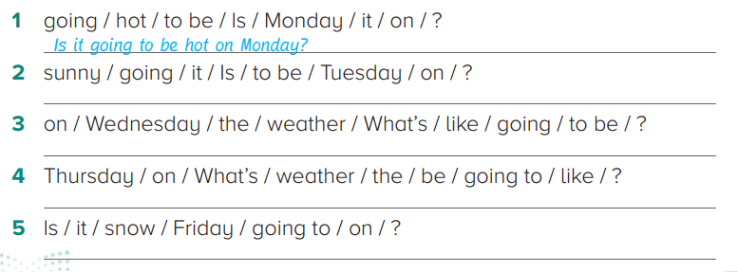
Order the words to make questions.
Yes, it is going to be hot
Is it going to be sunny on Tuesday?
Yes, it is going to be sunny
What’s the weather going to be like on Wednesday?
It is going to be sunny and hot
What’s the weather going to be like on Thursday?
It is going to be sunny
Is it going to snow on Friday?
No, it isn’t going to snow on Friday

Slide 12
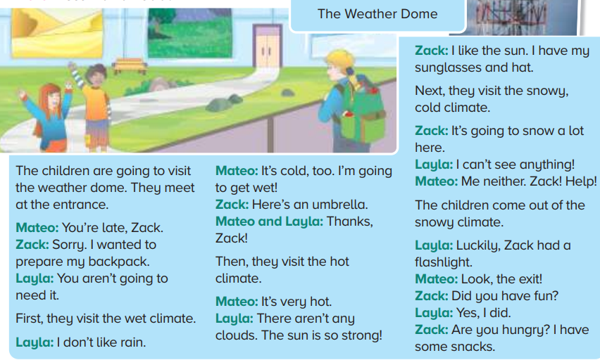
Reading
Weather الطقس
Dome قبة
Visitيزور
Meetيقابل
Entrance مدخل
Lateمتأخر
Prepareيعد
Backpackشنطة الضهر
Wetمبلل
Climateالمناخ
Strongقوي
Hungryجائع

Slide 13
Read the following and answer
It rains and it’s cold
3- Zack is happy because he is wearing a hat and sunglasses
4- Mateo and Layla can’t see in the snow
5- He has a flashlight so they can see
6- because he was prepared for all the different types of weather and he has snacks

Slide 14
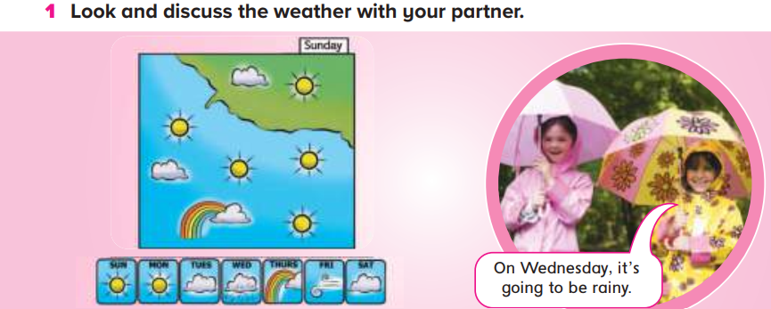
Practice time. Look and discuss the weather

Slide 15
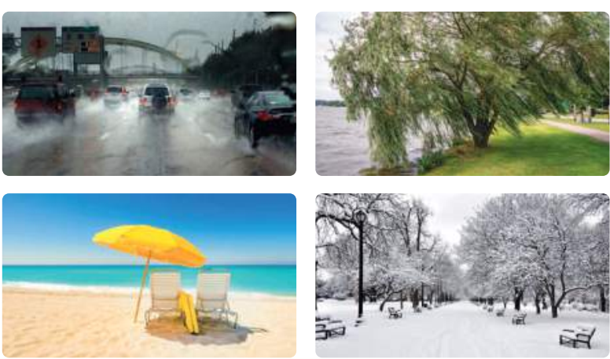
Look and describe the pictures and the weather

Slide 16
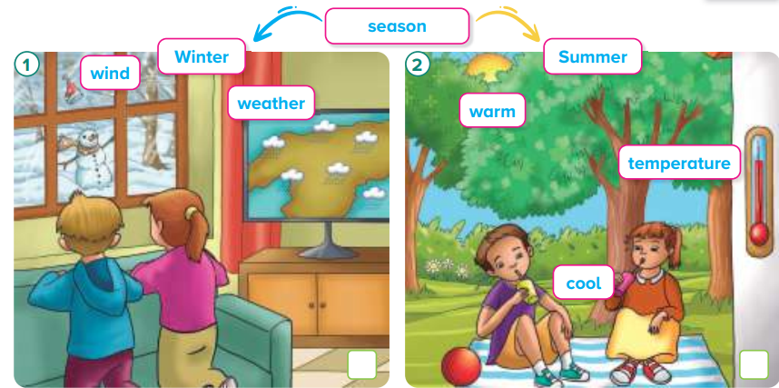
Wind الرياح
Winterالشتاء
Weatherالطقس
Seasonفصل
Summerالصيف
Warm دافئ
Temperatureدرجة الحرارة
Coolلطيف

Slide 17
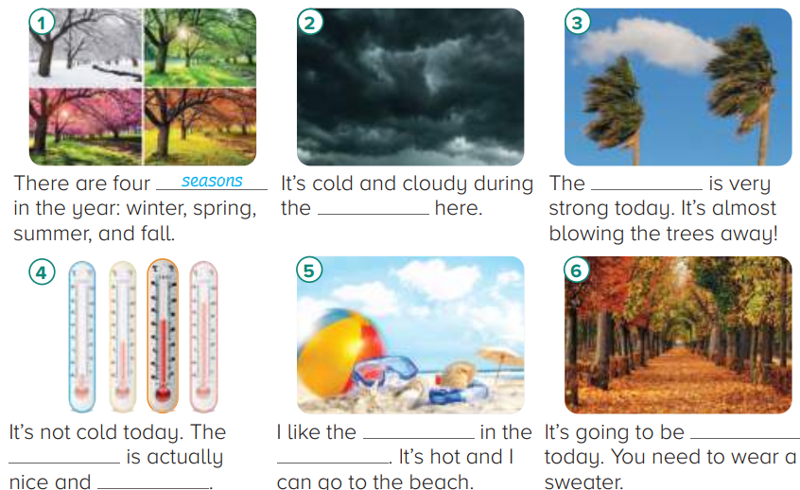
Look, read and write
wind
winter
weather
cool
temperature
summer
warm

Slide 18
Read the following
What is the weather like ?
What was the weather like?
It is snowy
It was sunny

Slide 19
Write the correct number
2
1
4
5
3
6

Slide 20
Read and complete the chart
is
isn’t
was
was
wasn’t

Slide 21
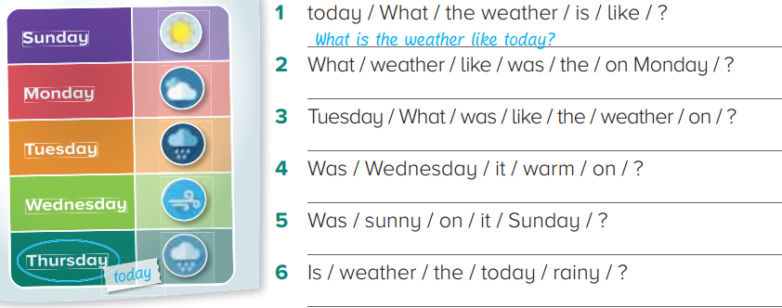
Order the words to make questions and answer
What was the weather like on Monday?
What was the weather like on Tuseday?
Was it warm on Wednesday?
Was it sunny on Sunday?
Is the weather rainy today?

Slide 22
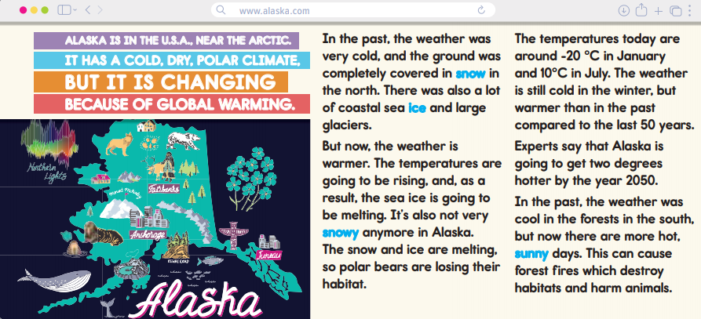
Reading
Near قريب
Arctic القارة القطبية
Dry جاف
Changingمتغير
Global warmingالاحتباس الحراري
Past الماضي
Northالشمال
Coastal seaالبحر الساحلي
Glaciersنهر جليدي
Riseيرتفع
Meltيذوب
Loseيخسر
Habitatموطن
Januaryيناير
Julyيوليو
Expertsالخبراء
Southالجنوب
Forest firesحرائق الغابات
Destroy يدمر
Harm يؤذي

Slide 23
e
b
a
c
It was cold and snowy
The weather is warmer now
Yes, they are
It was cool
It can be hot and sunny

Slide 24
Look and describe the pictures
In picture a, bare tree, green hill, blue sky and white clouds. It is early spring
In picture b, Lush green tree, flowers, blue sky : warm and sunny. It is summer
In picture c, bare tree, snow, pale sky: cold and snowy. It is winter

Slide 25
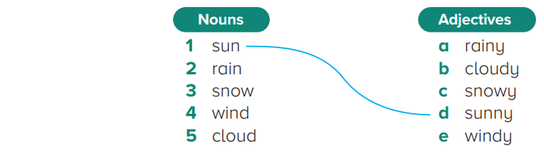
Read and match

Slide 26
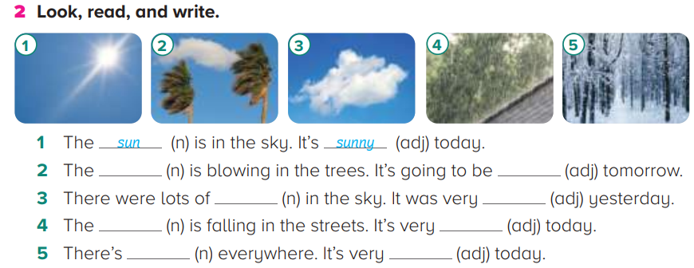
Look, read and write
wind
windy
clouds
cloudy
rain
rainy
snow
snowy

Slide 27
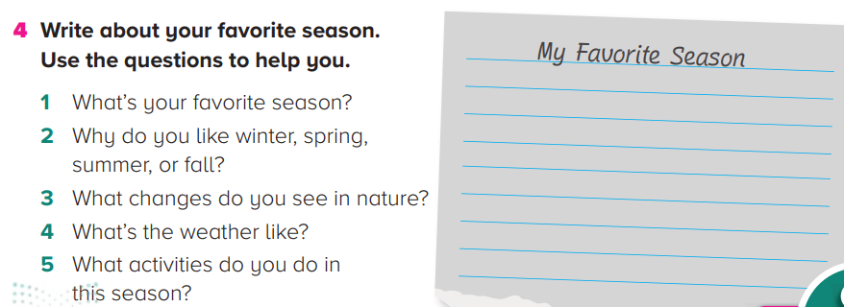
Write your favorite season

Slide 28
Reading
Logo شعار
Imagesصور
Wordsكلمات
Shapesأشكال
Designتصميم
Identityهوية
Meaningمعني
Communicateيتواصل
Messagesرسائل
Reflectيعكس
Visionرؤية
Valuesقيم
Representتمثل
Technologyتكنولوجيا
Natureالطبيعة
`4
Communityمجتمع
Sustainabilityالاستدامة
Livability سهولة العيش

Slide 29
Write the words in the correct place
echnology
ommunity
ature
ustainability
ivability

